Slide 1
Analysis of Seoul public transportation usage
Intermediate Project Presentations
team: 민트초코
2017038023 반예린
2015023025 배나영
2018038003 엄은지

Slide 2
Contents
1. Team members and roles of each member
2. Introduction to dataset
3. Plan for optimization
4. Schedule

Slide 3
Team members and roles of each member
반예린
Done
Collecting Data
Create queries and visualize data
-About the number of people ride and alight the bus by time/route/station
-About the number of people ride and alight the subway by time
To do
Bus Data Optimization
Bus Alight Data analysis
배나영
Done
Collecting Data
Create queries and visualize data
-About the number of people ride and alight the subway by line/station
To do
Subway Data Optimization
Subway Data analysis
엄은지
Done
Collecting Data
To do
Bus Ride Data analysis

Slide 4
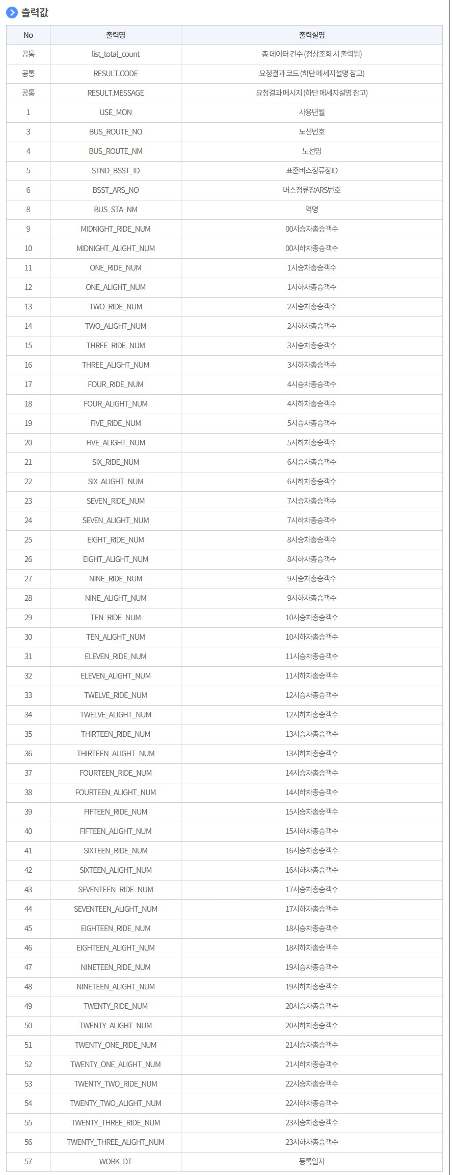
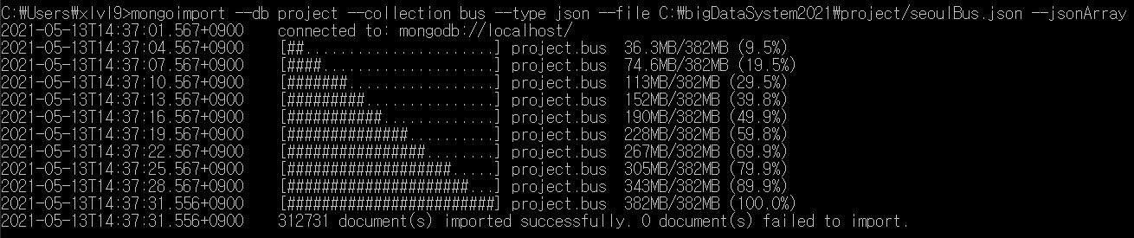
Introduction to dataset (1)
Seoul bus data: the number of people ride and alight the bus by time/route/station
(2020. 9. 3 ~ 2021. 5. 3)

Slide 5
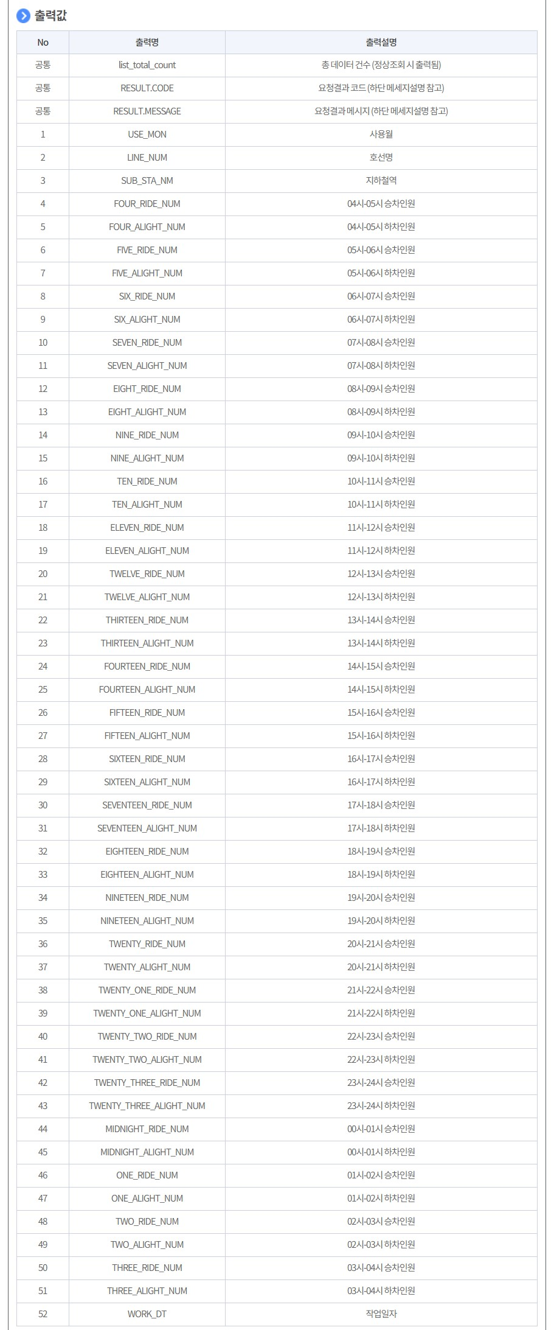
Introduction to dataset (2)
Seoul subway data: the number of people ride and alight the bus by time/line/station
(2015. 12. 23 ~ 2021. 5. 3)

Slide 6
Plan for optimization
Optimization method
Bus Data Indexing: About bus_route_no(route num), bus_sta_nm(station name) Field
Subway Data Indexing : About sub_sta_nm(station name), line_num(line name) Field
Check optimization performance
Comparison of execution times for the pre-optimization query and the post-optimization query

Slide 7
Schedule
Date | What to do | State
5/3 ~ 5/9 | *Subject selection and data collection *Delete the document corresponding to a field that doesn't exist or has a null value | Complete
5/10 ~ 5/16 | *Create queries and visualize data about the number of people ride and alight the bus by time *Create queries and visualize data about the number of people ride and alight the subway by time | Complete
5/17 ~ 5/23 | *Create queries and visualize data about the number of people ride and alight the bus by route *Create queries and visualize data about the number of people ride and alight the subway by line | Complete
5/24 ~ 5/30 | *Create queries and visualize data about the number of people ride and alight the bus by station *Create queries and visualize data about the number of people ride and alight the subway by station | Complete
5/31 ~ 6/6 | *Optimization *Data analysis | Proceeding
6/7 ~ 6/13 | *Preparation of final project presentation | Expected

Slide 8
Thank You

